Slide 1
R Clinic
Session 8:
Getting to grip with model outputs

Slide 2
REMINDER: write down your email address for access to the Dropbox with slides and code.
We will be in this room until beginning of August

Slide 3
New R clinic timetable online
Let us know any other suggestions or refreshers you might want

Slide 4
Model summaries
aov() and lm() refresher
What does everything mean?
What values to report

Slide 5
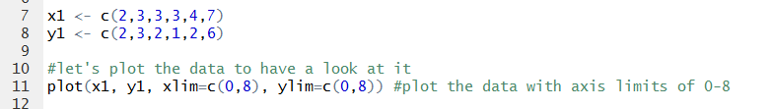

lm()
We’ll make up some data
Linear regression

Slide 6
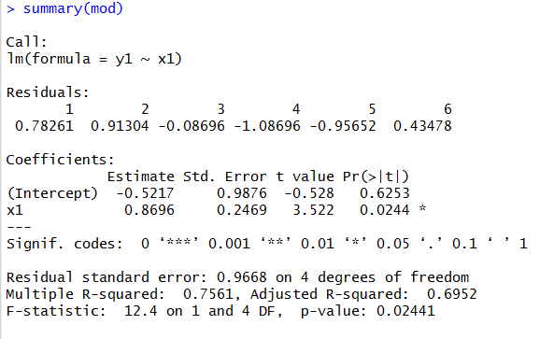
Model Summary

Slide 7

Model Summary
Small amount of data gives residuals
$$√\frac{var}{SSX}$$
P values and significance stars
Parameter estimates
Coefficient of determination

Slide 8
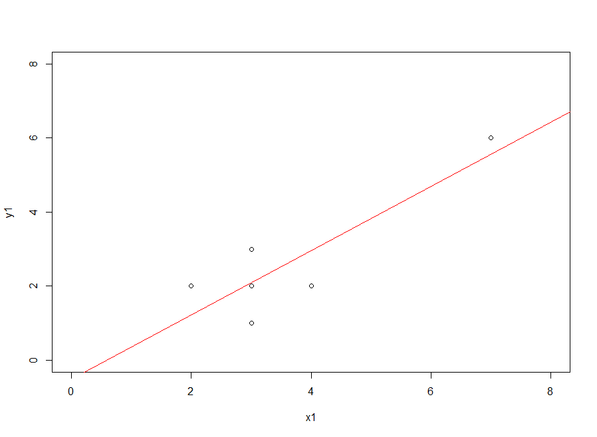
Equation of a straight line
y = mx + c
y = 0.87x - 0.52

Slide 9

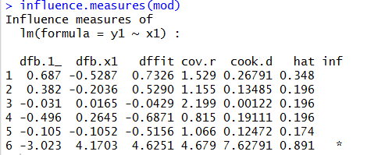
Outlier
How influential is the outlier?
Look at extreme values judged by (x - x̄)²

Slide 10

Analysis of Variance
Use data(InsectSprays)

Slide 11
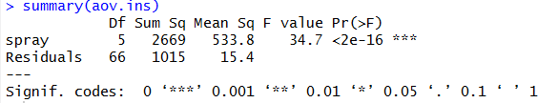
aov output
No effect sizes

Slide 12
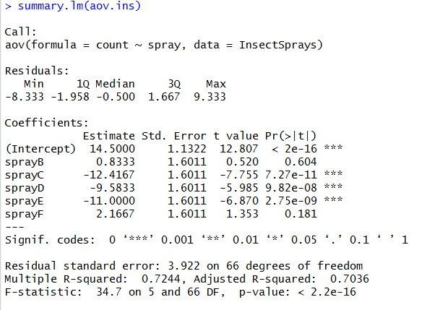

aov output
Standard error of difference between 2 means $√(2\frac{var}{n})$
Summary statistics of residuals
Estimates for differences between means
T test for differences between means
Coefficient of determination

Slide 13
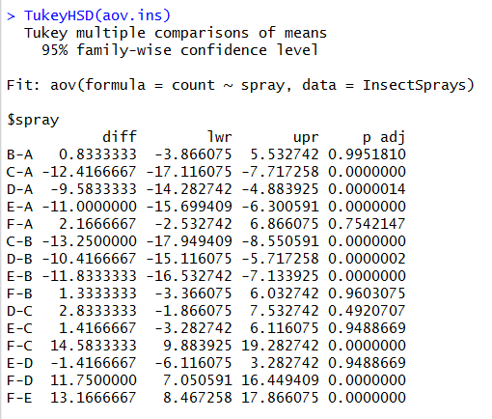
Post hoc test
Tukey’s HSD

Slide 14
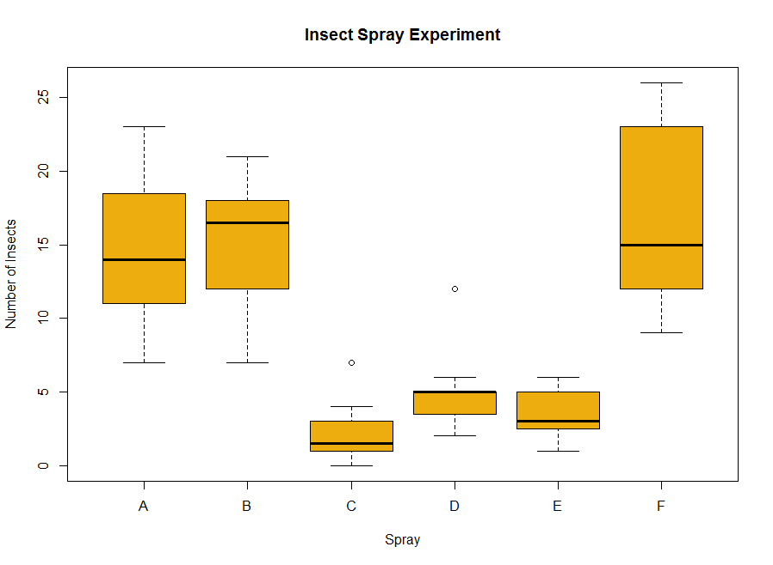
Let’s plot the data

Slide 15
Summary
Slope and intercept of line in lm()
Remember aov() coefficients with reference to first alphabetically
R squared is fraction of total variation in y that is explained by variation in x
Report coefficient estimate, some measure of variance and p val

Slide 16
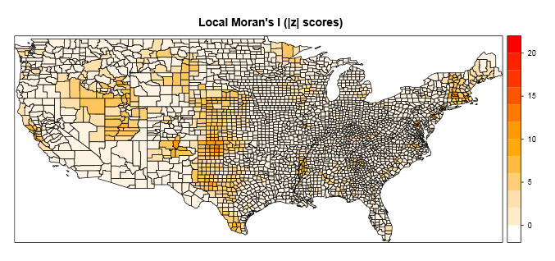
Next week
Spatial statistics…..a (very) brief introduction

